Slide 1

Introduction to Web Development and the MEAN Stack

Slide 2
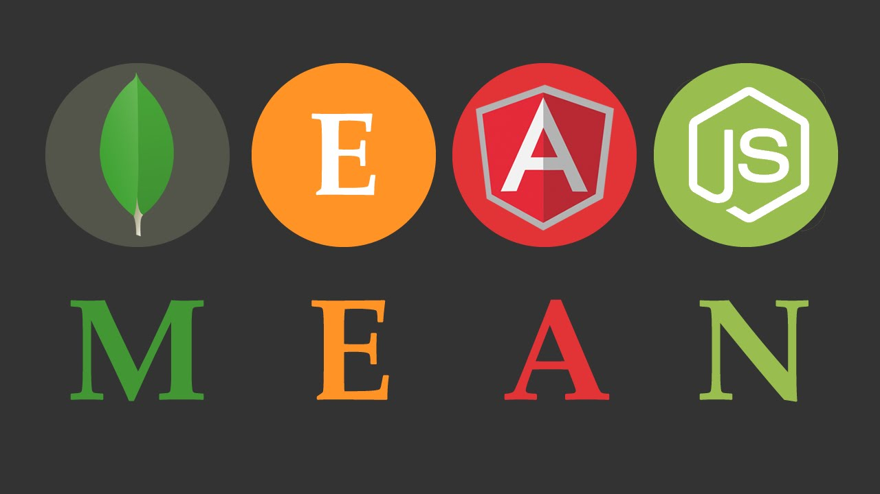

Slide 3
Overview of Web Development
Web development support to create, build, and maintain websites. It also covers database management, web development, web publishing, and web design. It's developing an online application, such as a website.
"web development" is a combination of two words:
Web: This term describes webpages, websites, and anything that operates online.
Development: This is the process of creating an application from the ground up.
Notes:
First unit is completely Theory

Slide 4
Classification of web Development
01
Front-end development, sometimes referred to as client-side development, is concerned with how a website or web application looks and feels to the user. Front-end developers design a website's visual and interactive elements using tools like HTML, CSS, and JavaScript.
FrontEnd Development
02
Developing the server and database components that drive a website or web application is known as back-end development, also referred to as server-side development. The logic, data storage, and server communication are handled by back-end developers.
Backend Development

Slide 5
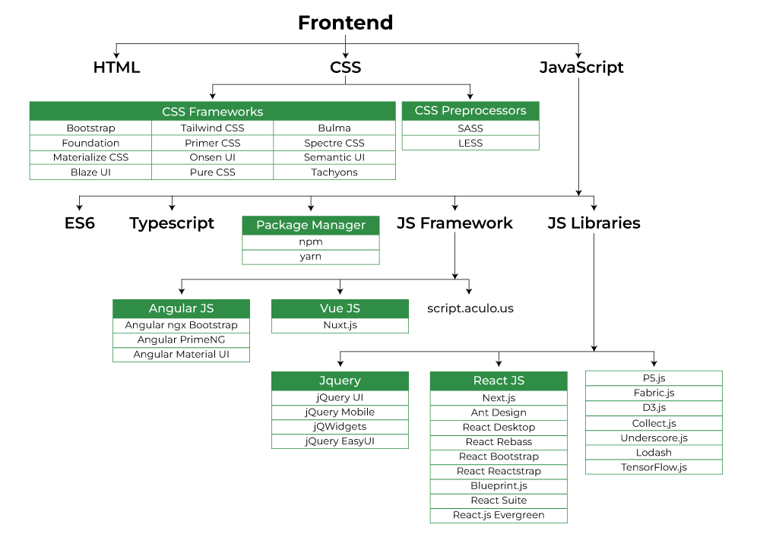
FrontEnd Roadmap

Slide 6
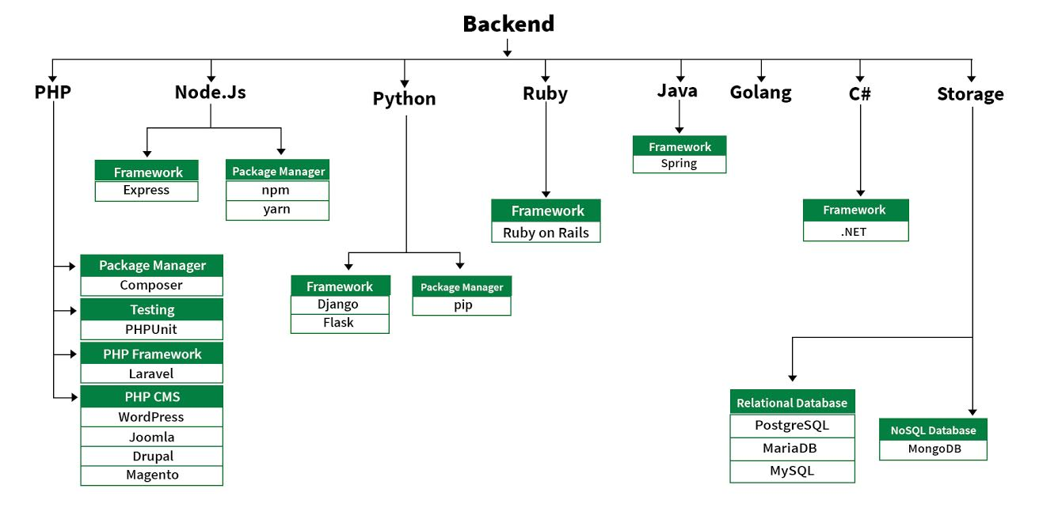
BackEnd Roadmap

Slide 7
Remember
Web development is?
A) method of creating logos
b) building and managing websites and web apps
c) social media marketing
d) a specific kind of web hosting service
B

Slide 8
Remember
Which of the following is not a commonly used web development framework or library?
a) React
b) Django
c) MySQL
d) Angular
C

Slide 9
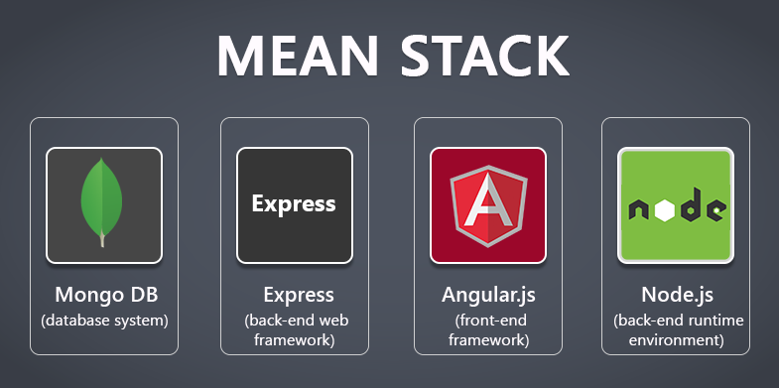
Introduction of MEAN stack
Among the most widely used technology stacks is MEAN Stack. It's employed in the creation of Full Stack Web Applications. Despite being a stack of several technologies, they are all built on the JavaScript language.

Slide 10
Components of MEAN stack
MongoDB
Express.js
Angular.js
Node.js
The Google Team created the open-source front-end framework Angular. Backward compatibility is preserved in the revision of this framework The Angular team's CLI (Command Line Interface) tool makes it easy to create Angular applications.
TypeScript CSS Preprocessor Template Code (Angular Material, HTML 5, etc.) are prerequisites for learning Angular
Javascript Server Side Code is written with Node.js. The fact that the JavaScript code is executed outside of the browser is among its most crucial features. It is open source and cross-platform.
Required to learn Node.js: TypeScript and JavaScript.
NoSQL database is MongoDB. It has documents in JSON format. The database is document-oriented.
Requirements for learning MongoDB:
DBMS
The drawbacks of the SQL database
Built on Node.js, Express is a web framework used to create online applications and APIs.
Required to learn Express are Node.js, JavaScript, and TypeScript.

Slide 11
Advantages of Mean Stack
JavaScript
Everywhere
MEAN is a full JavaScript framework, which means you can use JavaScript for both server-side and client-side development.
This reduces the need to learn multiple programming languages, thereby streamlining the development process.
Simplicity and Consistency
With the MEAN stack, you can use a single language (JavaScript) across the entire development stack.
This results in a more consistent code base and a simplified development process.
Efficiency and Productivity
The MEAN stack simplifies development and reduces the time needed to build and maintain applications.
Using a single language and integrated components speeds up the development process.

Slide 12
Advantages of Mean Stack
Scalability
The MEAN stack is designed to be scalable and can handle high loads, making it suitable for applications with varying levels of traffic and usage.
Cross-platform Compatibility
MEAN stack applications can be easily deployed on multiple platforms and environments, including cloud hosting services, which offer flexibility and accessibility.
Open Source
All components of the MEAN stack are open source, which means you can use them without incurring licensing costs.
Notes:
So many advantages of mean stack above are some example cant put everything on slides.

Slide 13
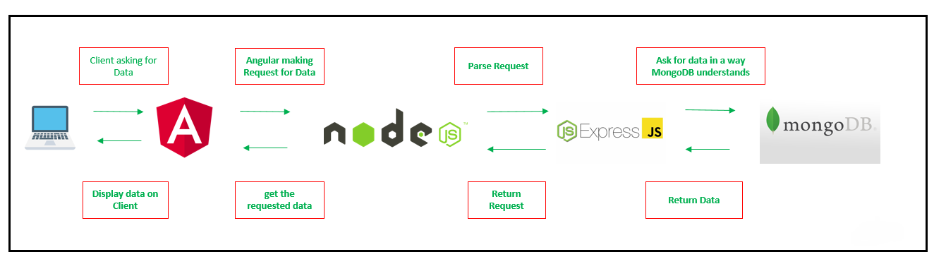
WorkFlow of the MEAN stack application

Slide 14
Understand
What is a NoSQL database system in the context of the MEAN stack?
a) Express.js
b) Angular
c) Node.js
d) MongoDB
B

Slide 15
Remember
Which order is best for comprehending and learning the components of the MEAN stack?
a) Node.js, Angular, Express.js, MongoDB
b) MongoDB, Node.js, Express.js, Angular
c) Angular, Node.js, Express.js, MongoDB
d) Express.js, MongoDB, Angular, Node.js
B

Slide 16
Setting Up The Development Environment
Prerequisites
Install MongoDB
Installing MongoDB will be necessary before you can begin working with the MEAN stack to develop. MongoDB is available for download and installation on their official website. After installation, MongoDB can be used to manage and store the data for your application.

Slide 17
Setting Up The Development Environment
Prerequisites
Configuring Express.js
The next step is to configure Express.js, which is the MEAN stack's web application framework.
The Node Package Manager (npm), included with Node.js, is used to install Express.js.
You can make a new Express.js application and set it up to meet the needs of your project.

Slide 18
Setting Up The Development Environment
Prerequisites
Setting Up AngularJS
You can download the AngularJS library from their website or utilize a Content Delivery Network (CDN) to reference it in your project if you want to use AngularJS. Once integrated, AngularJS may create dynamic and interactive web interfaces.

Slide 19
Setting Up The Development Environment
Prerequisites:
Installing Node.js
You must install Node.js to execute your application, as it is a crucial part of the MEAN stack. The most recent version of Node.js is available for download and installation on their official website.
Once installed, you can run your server-side JavaScript code and launch your MEAN stack application using Node.js.

Slide 20
Creating a Simple MEAN Stack Application
Plan and Design the Application
Create The Backend with Node.js and Expree.js
Implement the Frontend with Angular JS
Integrate with MongoDB to perform Database Operations

Slide 21
Deploy the Mean Stack Application
First choose the hosting provider
Deploy the application on server
Scal the application for high traffic

Slide 22


Slide 23
Thank You

